Slide 1
DevSecOps & Automation Newsletter

Slide 2
WHY DevSecOps ?

Slide 3
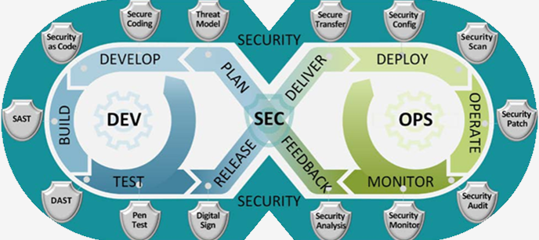
DevSecOps 2023
Implement Lean practices through DSO maturity coverage for 70% of high ROI products (~120 applications)and achieve overall DSO maturity level of 3+ . Complete assessments & re- assessments for 180+ applications for benchmarking and adding value to applications.
OKR
What is DevSecOps?
Implement lean Principled and bridges the gaps between development, security, and operations - continuous learning, collaboration, and security integration will yield shorter feedback loops, fewer bottlenecks, and fewer vulnerabilities.

Slide 4




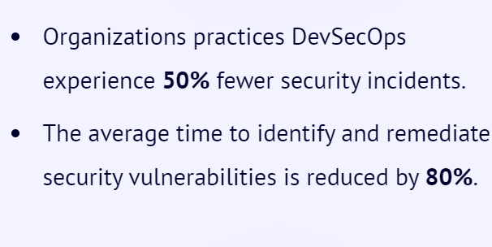
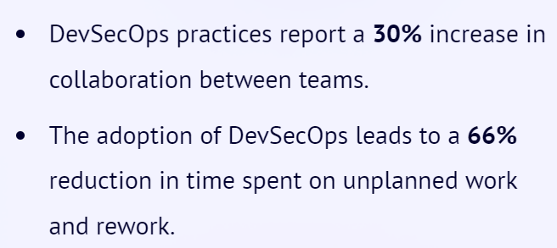
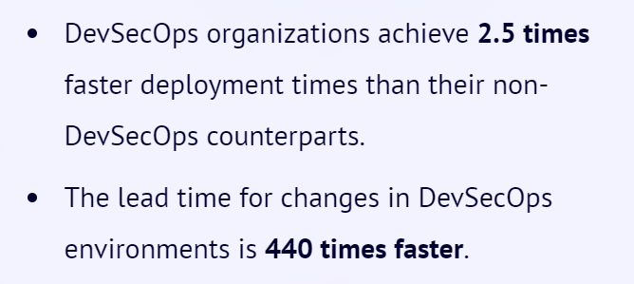
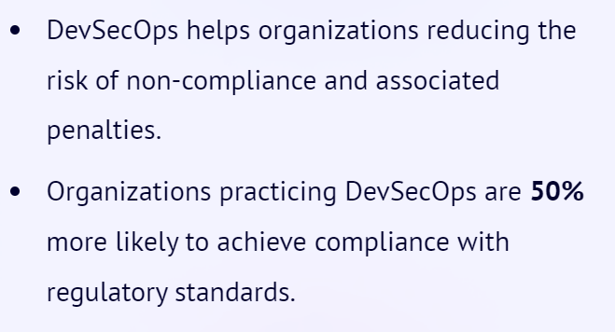
Why Implement DevSecOps?
Improved Security
Collaboration
Time to Market
Compliance
Notes:
Source:1) DevSecOps Community Survey
2) Puppet State of DevOps Report (https://www.puppet.com/resources/state-of-devops-report)

Slide 5
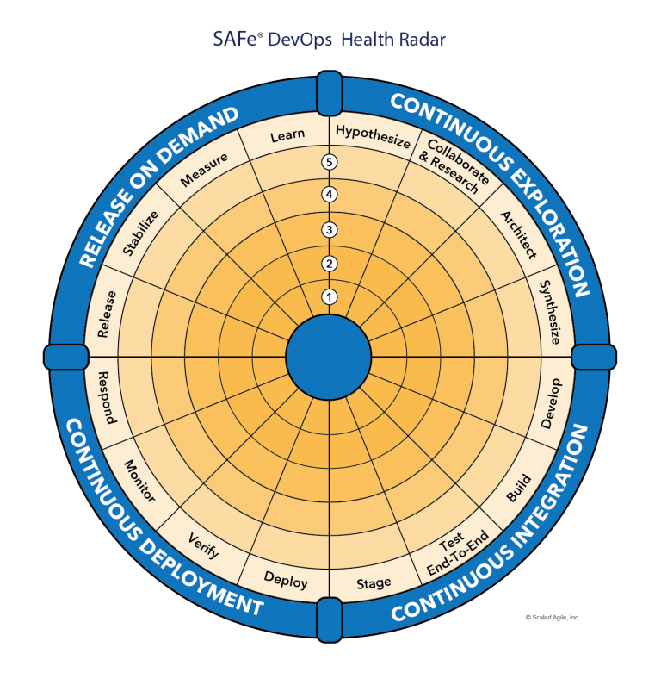
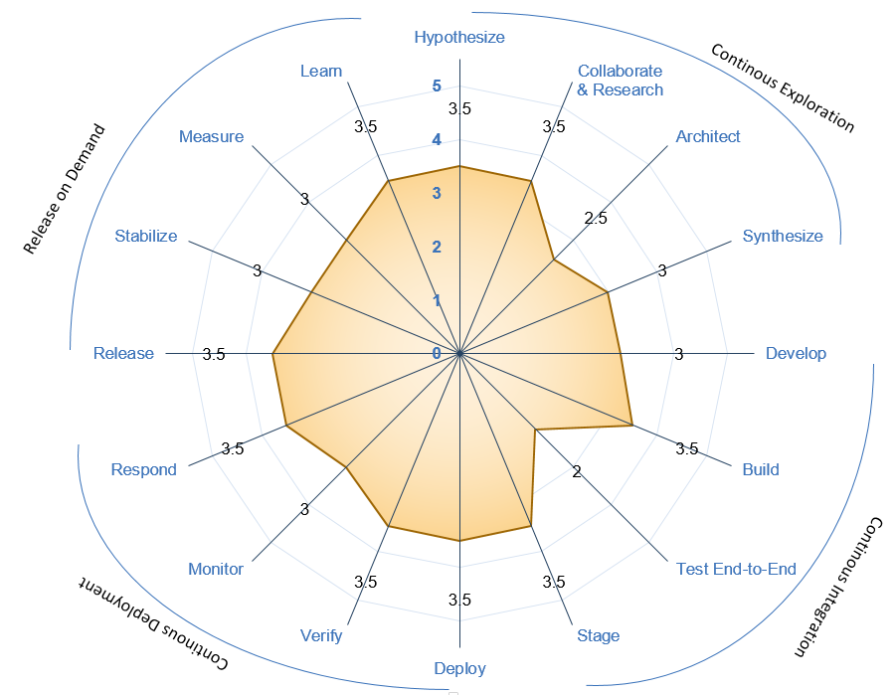





Understanding DevSecOps Maturity
Maturity Level | Stage | Stage Adoption | % of Adoption
Level 1 (Sit) | Initial | Yet to Start; Traditional environment and mindset | <=20%
Level 2 (Crawl) | Emerging | Beginning of change and agility; Initiated automation; | 21%-50%
Level 3 (Walk) | Practicing | Started Practicing; Transformation happening with defined process and automation | 51%-70%
Level 4 (Run) | Optimizing | High in Adoption ;Optimizing the existing practices and following Continuous improvement | 71%-90%
Level 5 (Fly) | Leading | Being a leader in adoption; | >90%
Recommended minimal level for DSO Adoption
Maturity Level
Sit
Level 1
Crawl
Level 2
Walk
Level 3
Run
Level 4
Fly
Level 5
1- Low & 5-High Maturity

Slide 6
Success STORIES AFTER REASSESSMENT

Slide 7


Savings identified after reassessment 2023
9512 Hrs. (As of Oct 2023)
27 Applications in pipeline for reassessment in 2023

Slide 8
CASTeam (Commercial Aviation Services Tool & Equipment Applications for Maintenance) Success stories (l3 to l4) Total Savings in a year 4047 hours = (102 Prod CI/cd + 3195 dev CI/CD + 750 coverity pipeline automation)
CI/CD
Development
3 Production Releases
Manual Effort = 4.5hrs
Automated = 0.25hrs
50+ Non Prod Deployments
(30 dev + 10 stage+10 test )
Per sprint (50 * 4.25) = 213hrs
23 to 84% Unit test Coverage improvement
Automated Protractor tests during Releases.
Coverity Pipeline savings
Per Sprint
( 50 scans * 1 hr) = 50 hrs

Slide 9
MIST – (Modular instrumentation setup tool) Success stories (l1 to l3) Total Savings In A Year 2304 hours = (1536 CI/cd + 768 development)
Configuration Management Practice followed which increases agility, both on the part of individual developers and the application as a whole.
Features:
Externalized
Environment Specific
Consistent
Version History
CI/CD
Development
4 Non-Production Deployment
Configuration Management Practice followed.
Manual Effort = 5 hr
Automated = 1.5 hr
Per Sprint(4env*4hr*8build=128 hr)
SAST tool in pipeline helps to ensure no new security vulnerabilities go to Production. Address security and quality defects early in the software development.
8 Story Point Task X 8 hrs = 64 hrs

Slide 10
GSESP (Ground Support Equipment supply partner) Success stories (l3 to l4) Total Savings in a year 2265 hours = (30 Prod CI/cd + 1710 dev CI/CD + 525 coverity pipeline automation)
CI/CD
Development
15 to 70% Unit test Coverage improvement for GSESP
Automated Protractor tests during Releases.
Coverity Pipeline savings
Per Sprint
( 35 scans * 1 hr) = 35 hrs
3 Production Releases
Manual Effort = 3.5hrs
Automated = 0.25hrs
35+ Non Prod Deployments
(25 dev + 5 stage+ 5 test )
Per sprint (35 * 3.25) = 114hrs

Slide 11
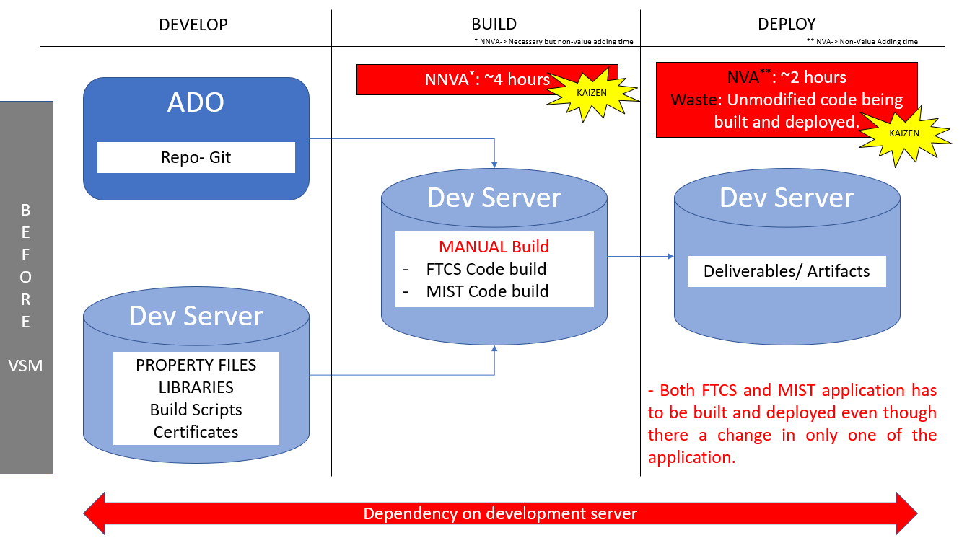
DSO improvement case study using vsm(Value stream mapping)
Challenges in Legacy apps (FTCS/MIST)
App code was in ADO and other dependencies
were maintained in dev server. Challenge in
tracking version for these dependencies.
As the apps are legacy the builds were manual
& tightly coupled.
Small change in any files required complete
shutdown of entire app for 4 hours.
Redundancy – Some Configuration files were
available in different/duplicate locations. Overhead
in maintaining.
Too much idle time and Waste - Unmodified
code being built and deployed.

Slide 12
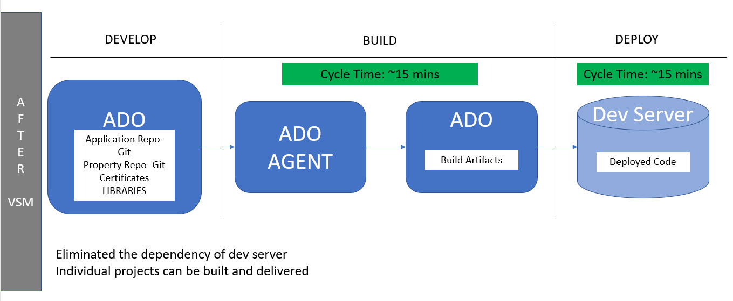
DSO improvement case study using vsm (Value stream mapping)
Mitigating challenges in legacy apps
Migrating app code and other dependencies at to
one place in ADO. Eliminated the dependency of
DEV server during build.
Maintaining and versioning of config files are now
easy with GIT support. Redundancy and overhead is
reduced.
Build process was automated using ADO build
agents, reducing the waste and downtime of the
applications. Need to rebuild unmodified apps is
eliminated by reuse of artifacts from previous build.
Configuration changes (like DB credentials,
WSSO config changes etc) are implemented by
server restarts than build and deploy.
“Build Once; Deploy Anywhere” strategy adopted
with the help of CI-CD implementation.

Slide 13
Automation Case study : 1
Project Name: Linux-based LDRA Licenses Implementation
Problem Statement: BFMS is working hard on their development productivity to meet 737MAX and FAA milestone schedules. They required more LDRA licenses as they were maxing out. Their current Windows-based LDRA licenses allowed them to perform instrumented builds weekly due to slow cycle time.
Solution: BFMS learned they could increase their team’s productivity by using Linux-based LDRA licenses, which cycled in a quarter of the time of Windows-based LDRA. This permits them to perform daily builds vs weekly and thus increase their output.
Automation Hours Calculation:
The calculations for the conversion of saved Automation hours to dollars is illustrated below:
Savings is 3 hours per build
BFMS has 80 engineers actively working on structural code coverage analysis on a daily basis by running the tests and making fixes to either the code and/or test procedures.
Hours saved formula: 80 users X 1 build per day X 3 hours saved X 240 days = 57600 hours of saved
Engineer hourly rate is ~$215/hr
$215 x 57,600 hours saved = $12,384,000

Slide 14
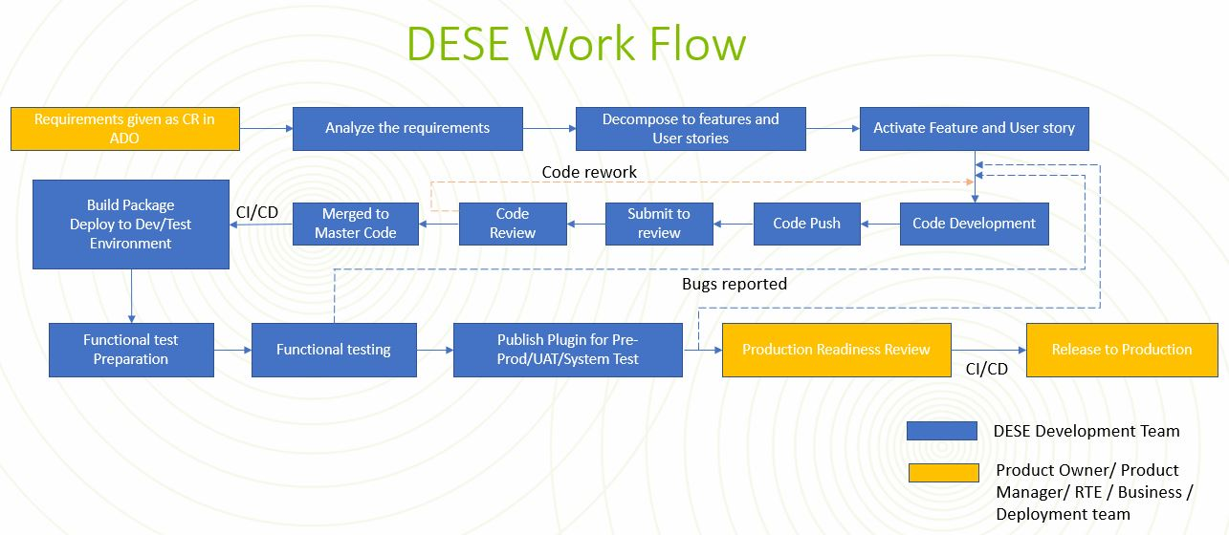
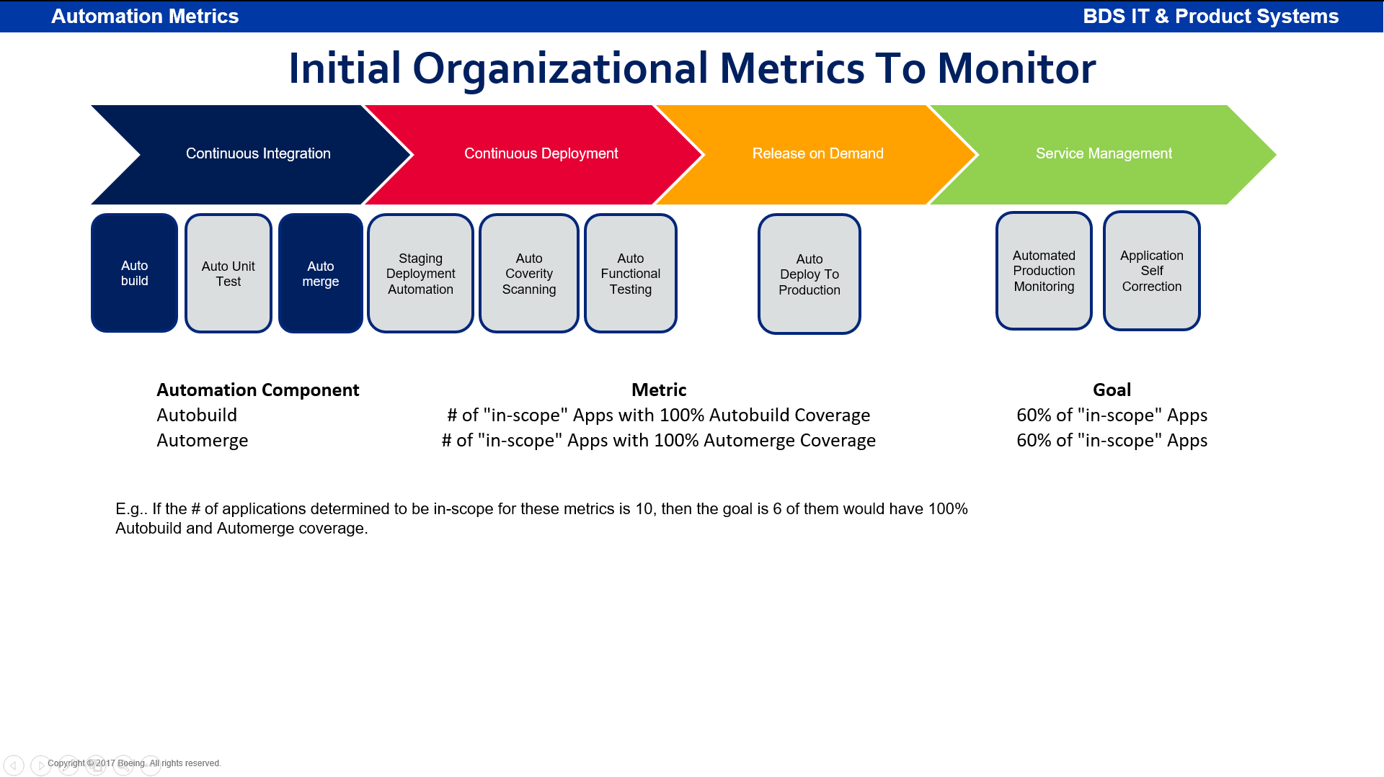
Automation Case study : 2
Project Name: DESE (Digital Environment for System Engineering)
Problem Statement: DESE creates solution, job aids, starter kit/models and training environment and deliver them to different Boeing Commercial and Defense Airplane programs and create an environment for integration with other MBSE tools like 3dxperience, Capital, etc.. They required tool to test plugin functionality, as manual testing was taking too much time
Solution: DESE learned that they could decrease the functional testing time by using IIR tool. Also they can reduce the manual build by CI/CD pipeline. This permits them to perform daily builds with automated FT which increased the output
Automation Hours Calculation:
The calculations for the of saved Automation hours:
Savings is 4 hours per build
DESE has 15 engineers actively working on code development on a daily basis by running the tests and making fixes to either the code and/or test procedures.
Hours saved formula: 322 build + 280 UT + 44 merge + 322 deployment + 106 coverity + 9920 FT = 11888 hours saved

Slide 15
Contact us
 | DRI | Project Management | Core Team | Enterprise Team & Champions
DevSecOps | Abhishek Singh Kenneth C Shew | Pramithi R Karimpanakkal | Singh, Abhishek K Valiyarayil, Siby Pattanaik, Anup K Ammata, Sudhakar Bakhedi, Bharati Bahubali Balraj, Bharath K Ghosh, Saikat Ghosh, Subhabrata Gundupalli, Rajesh Reddy H D, Sarika K L, Bharath Karri, Ram Sai K-R, Rahul Kuriakose, Tintu M Kurian, Abhijith Kuruba, Kuruba Chandra Kumar Mistry, Ashok Nagaraju, Ganesh Nagziriya, Anshika Nair, Aathira Manikandan Padmanaban Shunmugam, Nihila Panda, Pritam Prabhat, Kumar Radhakrishnan, Chinjumol Reddy, V Sanjeev Rompicherla, Rakesh Sawant, Swapnil Ravindra Varghese, Jessy Vinukonda, Basha Jayanta Mondal DL Product Systems - DevSecOps Core Team | Karthik Tirukkoylur Sekhar Dolly Bhaskara Arun Prakash Jeyaprakash Anandapadmanabhan Gopalakrishnan Sushil Mishra Donald R Wellington Brennan Y Lind DL DSO DRIs
Automation | Kenneth C Shew Naga Harsha Kaggallu | Priyanka Dhanpal Chougule

Slide 16
Thank You

